Slide 1

DOES HOSTING
THE OLYMPICS
PROVIDE HOME ADVANTAGE
IN GYMNASTICS?
PROJECT - TEAM 5

Slide 2

BACKGROUND
The Olympics is one of the world’s largest sporting events, and gymnastics.
Gymnastics relies heavily on subjective judging, creating potential opportunities for bias.
This project examines whether host nations gain a measurable competitive advantage in Olympic gymnastics using 124 years of data.
WHY GYMNASTICS?
Scoring depends on human judges → greater potential for national bias
Long historical data (1896–2020)
Rich data across nations, genders, and ages.
Ideal sport to study home advantage phenomenon

Slide 3

QUESTION 1:
DOES HOSTING PROVIDE
HOME ADVANTAGE?
1. Host nations win significantly more medals
Compare medal-winning rates between host and non-host countries.
2. Average Percentage Increase for Host Countries
Compare each host country’s hosting-year performance with its own historical baseline.

Slide 4
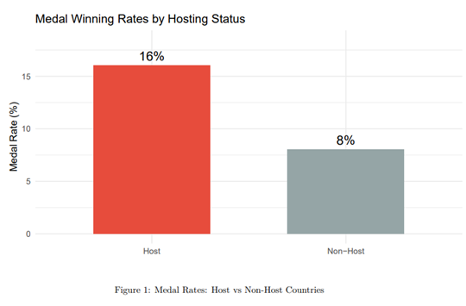
Host countries: 16.04% (361 medals / 2250 performances)
• Non-host countries: 8.03% (2112 medals / 26,304 performances)
• Difference: 8.02 percentage points
➡ Chi-square results show this difference is highly significant (χ² = 167.316, p < 2e−16), confirming host nations win significantly more medals.

Slide 5
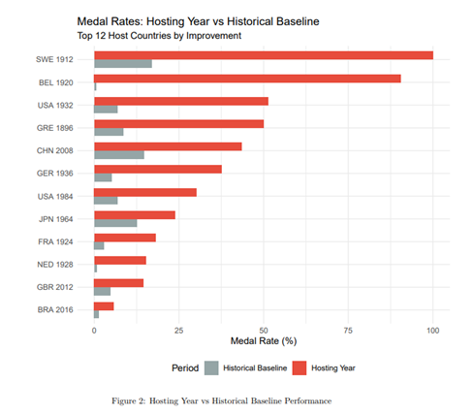

Slide 6

T-TEST
H0: Host and Non-host countries have the same medal-winning rate
Ha: Host and Non-host countries have different medal-winning rates
PAIRED T-TEST RESULT
T = 2.892
df = 28
p-value = 0.00732
95% CI for improvement: 3.85% to 22.55%
Average baseline: 7.27%
Average hosting year: 20.47%
Improvement: +13.2 percentage points
Since p < 0.05, We reject H₀ and conclude host nations perform significantly better during hosting years.

Slide 7

1. Gender Differences in Medal Rates
Compare male and female gymnasts to determine who benefits more from hosting.
QUESTION 2:
GENDER DIFFERENCES IN HOME ADVANTAGE
2. Gender Gap Over Time
Examine how home-advantage effects for men vs. women have shifted across Olympic eras.

Slide 8

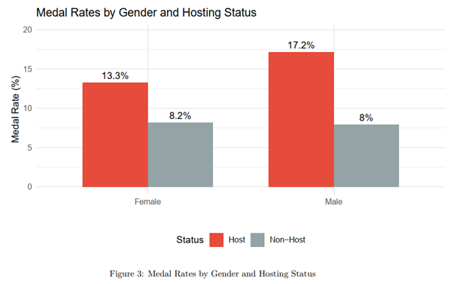
Male Gymnasts
• Host: 17.17%
• Non-host: 7.95%
• Difference: +9.22 percentage points
Female Gymnasts
• Host: 13.30%
• Non-host: 8.16%
• Difference: +5.14 percentage points
➡ Male gymnasts show a stronger home-advantage effect.

Slide 9

Male Gymnasts
• χ² = 153.609, df = 1
• p-value < 2e−16
• 95% CI: 7.29% to 11.15%
➡ Highly significant
Female Gymnasts
• χ² = 20.18, df = 1
• p-value = 7.05e−06
• 95% CI: 2.40% to 7.88%
➡ Significant
CHI-SQUARE TEST
Both genders show significant home-advantage effects, but male advantages are nearly double those of females.

Slide 10

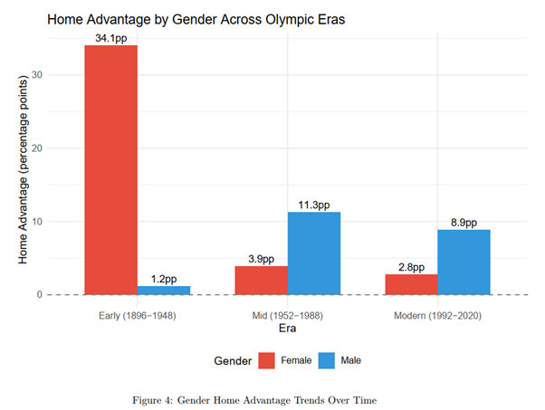
1896–1948
Early Era
• Female: 34.07 pp
• Male: 1.18 pp
Females had far stronger home advantage
1952–1988
Mid
Era
• Female: 3.86 pp
• Male: 11.3 pp
Shift: males gained more advantage
1992–2020
Modern Era
• Female: 2.76 pp
• Male: 8.88 pp
Males show consistently larger advantage

Slide 11

1. Do Smaller Countries Experience Larger Increases?
Compare medal improvements across large, medium, and small countries.
QUESTION 3:
COUNTRY FACTORS
2. Do First-Time Hosts Gain a Bigger Boost?
Compare hosting-year improvement between first-time and repeat hosts.
3. Do Host Nations Field More Gymnasts?
Evaluate whether hosts send larger teams, potentially increasing medal opportunities.

Slide 12

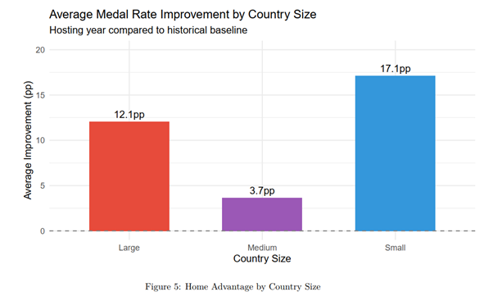
Average improvement by country size:
• Small countries: 17.14 pp (n = 15)
• Large countries: 12.06 pp (n = 9)
• Medium countries: 3.66 pp (n = 4)
Small countries show the largest improvement.
Chi-square test
• χ² = 1.934
• df = 2
• p = 0.38
Not significant
➡ Improvement varies but not statistically confirmed.

Slide 13

Average improvement:
• First-time hosts: 16.53 pp (n = 18)
• Repeat hosts: 8.27 pp (n = 10)
T-TEST — FIRST-TIME VS REPEAT HOSTS
• t = 0.981
• p = 0.336
No significant difference
➡ Although first-time hosts show numerically larger boosts, the difference is not statistically significant.

Slide 14

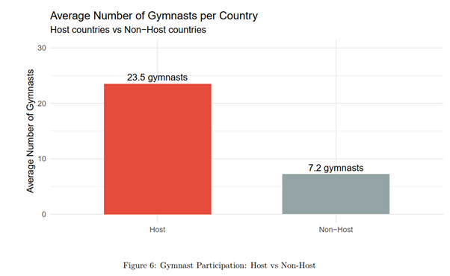
Average number of gymnasts per country:
• Host countries: 23.5 gymnasts
• Non-host countries: 7.2 gymnasts
Difference: +16.3 more gymnasts for host nations
T-TEST - HOST VS NON-HOST PARTICIPATION
• t = −3.328
• p = 0.00245
HIGHLY SIGNIFICANT
➡ Host countries field much larger teams, which may increase medal opportunities.

Slide 15

1. GDP per capita & home advantage
Examine whether richer countries gain larger improvements when hosting.
QUESTION 4:
ECONOMIC & DEMOGRAPHIC
2. Working-age population share & home advantage
Test whether countries with more working-age citizens perform better when hosting.

Slide 16

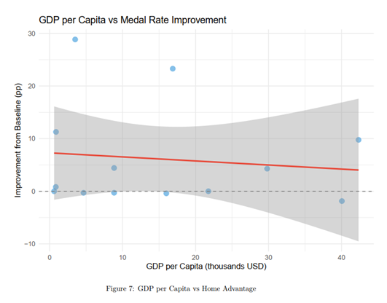
GDP per capita vs medal rate improvement
• Correlation coefficient: –0.115
• P-value: 0.708
No significant relationship
➡ Wealth does not predict whether a country gains higher medal improvements when hosting.

Slide 17
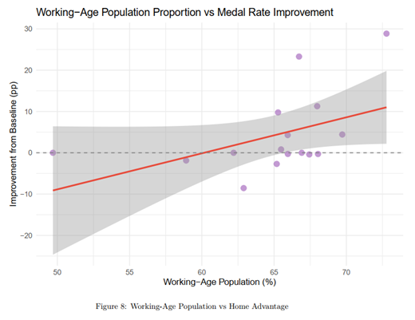
Working-age population (%) vs improvement
• Correlation coefficient: 0.461
• P-value: 0.072
Not statistically significant (but trending positive)
➡ Countries with larger working-age populations show some positive trend, but it is not statistically significant.

Slide 18

REFERENCES
[1] N. Sharma, “Olympics 124 years dataset till 2020,” Kaggle, 2020. [Online]. Available: https://www.kaggle.com/datasets/nitishsharma01/olympics-124-years-datasettill-2020
[2] P. Fomichev, “Olympic Games hosts,” Kaggle, 2022. [Online]. Available: https://www.kaggle.com/ datasets/piterfm/olympic-games-hosts
[3] Our World in Data, “Population by age group,” 2023. [Online]. Available: https://ourworldindata.org/ grapher/population-by-age-group
[4] Worldometers, “Largest countries in the world by area,” 2024. [Online]. Available: https://www. worldometers.info/geography/largest-countries-in-the-world/
[5] The World Bank, “GDP (current US$),” World Bank Open Data, 2024. [Online]. Available: https: //data.worldbank.org/indicator/NY.GDP.MKTP.CD

